Slide 1
Semester 4
Sistem Desain Mekatronika

Slide 2
Team 2
01
Aditya Bayu Pratama [4211711003]
Product Design, Programmer, Electrical
02
Aldi Afandi [4211611019]
Programmer, Database
03
Imanuel Panjaitan [4211711005]
Electrical, Mechanical
04
Ade Suhendra [4211831002]
Mechanical, Instrument
05
Friska Dwi Lisnawati [4211711012]
Electrical, Documentation, Project Management

Slide 3
Akses Pintu Anda masih Manual ?
Bagaimana dengan Sistem Smart Lock Door?

Slide 4
Apa itu Smart Lock Door ?
SEJARAH
PENGERTIAN
FUNGSI
MANFAAT
KELEBIHAN
KELEMAHAN

Slide 5
Smart Multi Function Door Lock System
SMFDLS

Slide 6
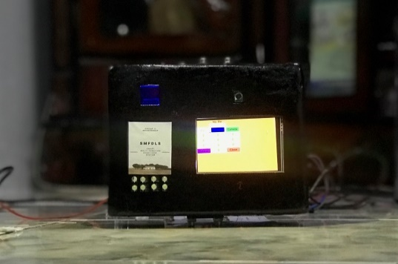
 | FINGER PRINT
 | FACE RECOGNIZE
 | PIN NUMBER
 | MOBILE APPLICATION

Slide 7
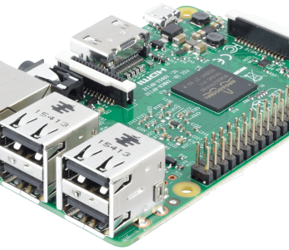
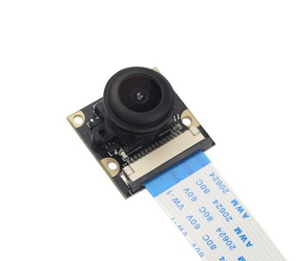
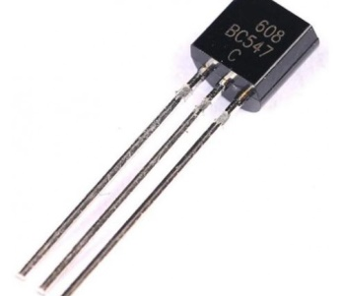
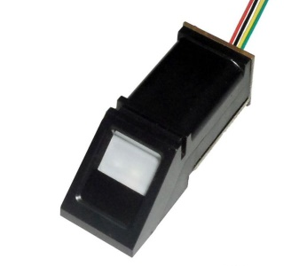
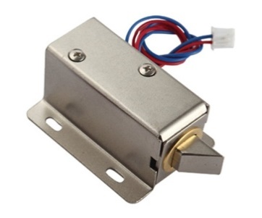
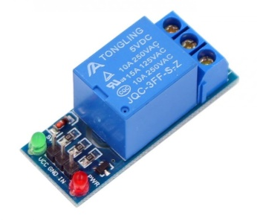
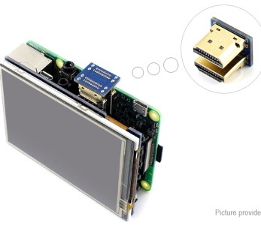
Komponen Utama
Raspberry PI 3b
Finger Print
Kamera
Raspberry PI 3b
Transistor
BC547
Selonoid
Lock Door
Modul Relay
LCD

Slide 8
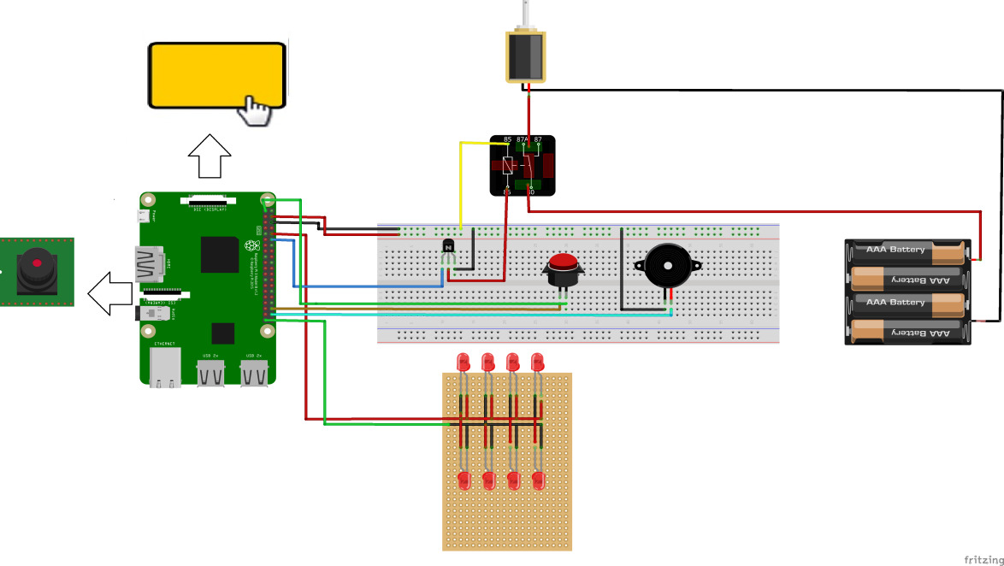
Desain Electrical Wiring

Slide 9
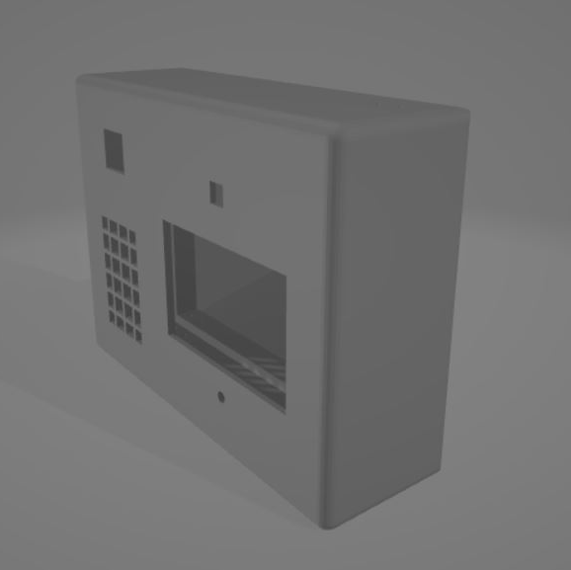
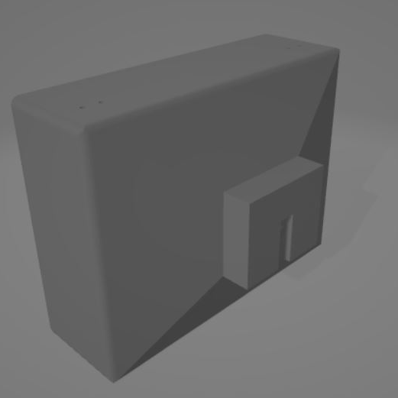
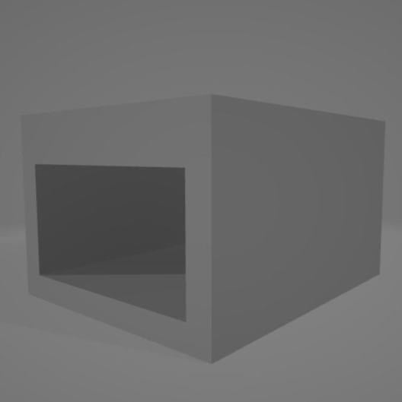

DESAIN PRODUK SMFDLS
MODERN
PRAKTIS
AMAN
EFEKTIF

Slide 10

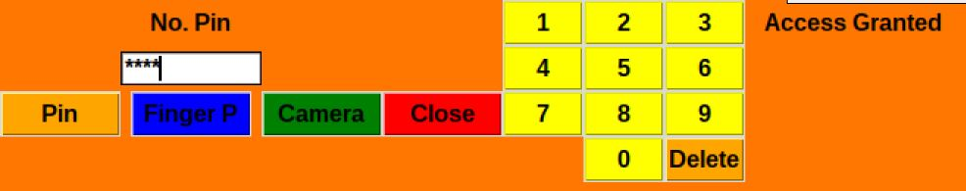
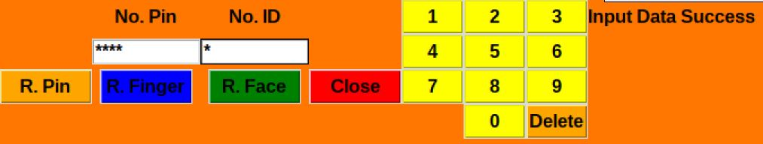
INTERFACE SMFLDS

Slide 11
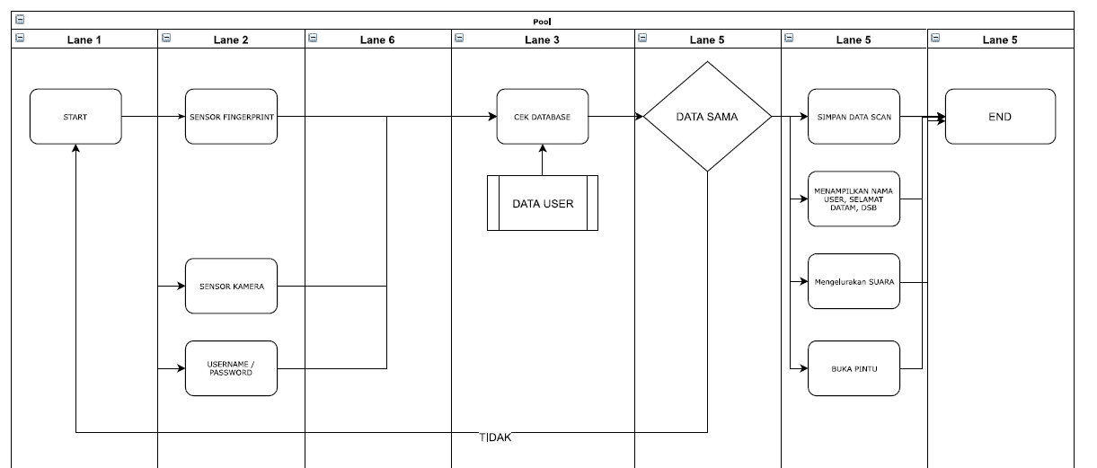
FLOW CHART SISTEM
-40
-40
-40
-40

Slide 12

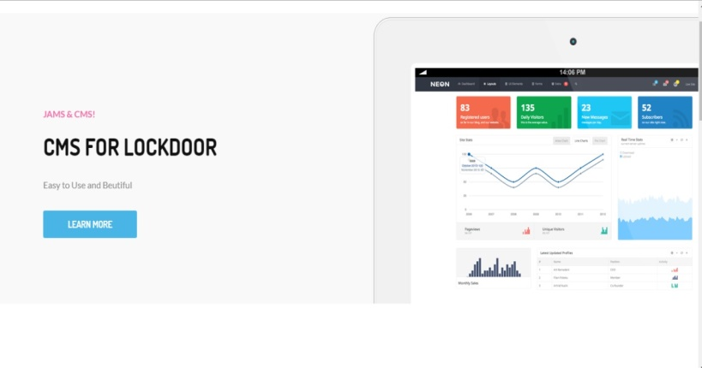
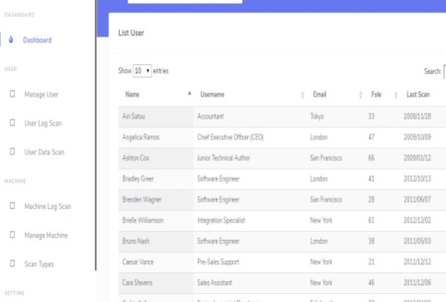
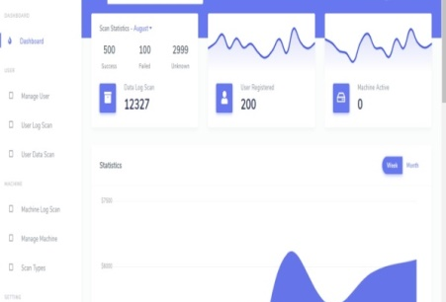
DESAIN
ADMIN INTERFACE

Slide 13
PROGRAM DAN DATABASE
PROGRAM
DATABASE
BAHASA PEMOGRAMMAN PHYTON
PHPMYADMIN DAN API

Slide 14
DATA PENGAMATAN
Face Recognition Data
No | Nama | Total Image | Time (s)
 |  |  | Register | Access
1 | Aditya | 27 | 300 | 42
2 | Friska | 30 | 420 | 39
3 | Imanuel | 33 | 520 | 50
4 | Aldi | 32 | 200 | 35
Finger Print Data
No | Nama | Finger ID | Time (s)
 |  |  | Register | Access
1 | Aditya | 1 | 20 | 6
2 | Friska | 2 | 17 | 5
3 | Imanuel | 3 | 15 | 8
4 | Aldi | 4 | 22 | 5
Pin Number Data
No | Nama | No. Pin | Time (s)
 |  |  | Register | Access
1 | Aditya | 711003 | 5 | 4
2 | Friska | 711012 | 6 | 4
3 | Imanuel | 711005 | 8 | 6
4 | Aldi | 711004 | 5 | 5

Slide 15
PROBLEMA
ELECTRICAL
PROGRAM
RELAY
GUI
ELECTRICAL
ELECTRICAL
MECHANICAL
RFID
USB
CASE 3D PRINTING

Slide 16
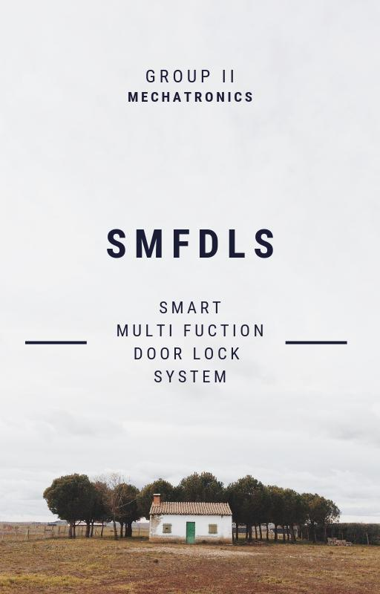

Slide 17
Thank You

